Slide 1
TITANIC
— SC1015 —
FEL1 Group 1
Tristan Ng Chong Xu
Chooi Li Hang
Cadden Chua Chung Han
U2322828G
U2322198C
U2322788J

Slide 2
Flow of Presentation
Exploratory Data
Analysis (EDA)
Visualisation
01
02
03
04
05
Problem & Goals
Machine Learning
Insights

Slide 3
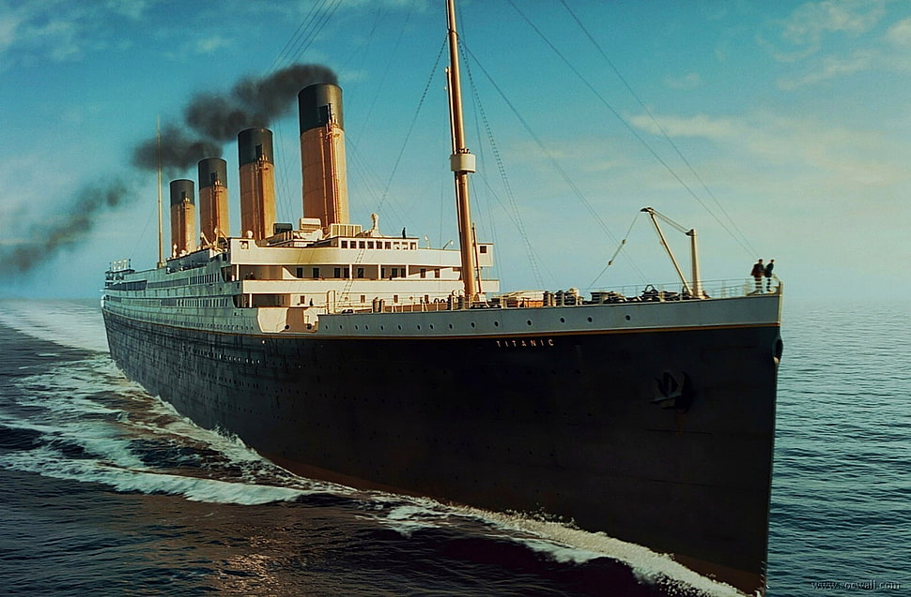
What is Titanic
Notes:
RMS Titanic: A British passenger liner operated by the White Star Line.

Slide 4
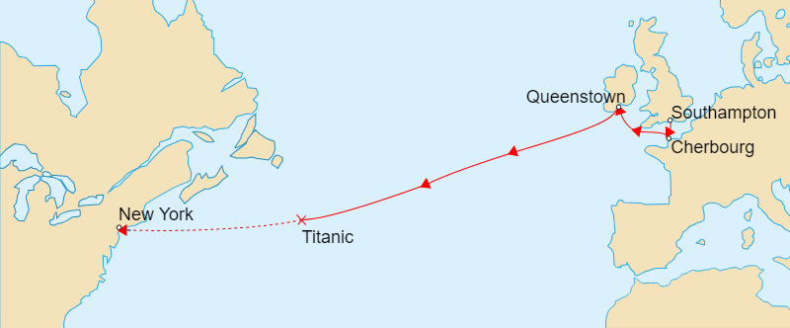
Route
Notes:
Maiden Voyage: Departed from Southampton, England, on April 10, 1912.
Destination: Intended location is New York City, USA.

Slide 5
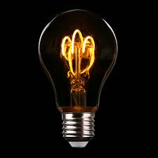
PROBLEM DEFINITION
Build a predictive model to determine which passengers survived the Titanic disaster.
Identify key features influencing survival likelihood and evaluate the model's accuracy in predicting individual outcomes.

Slide 6


Motivations
Historical Significance
Real-world relevance

Slide 7
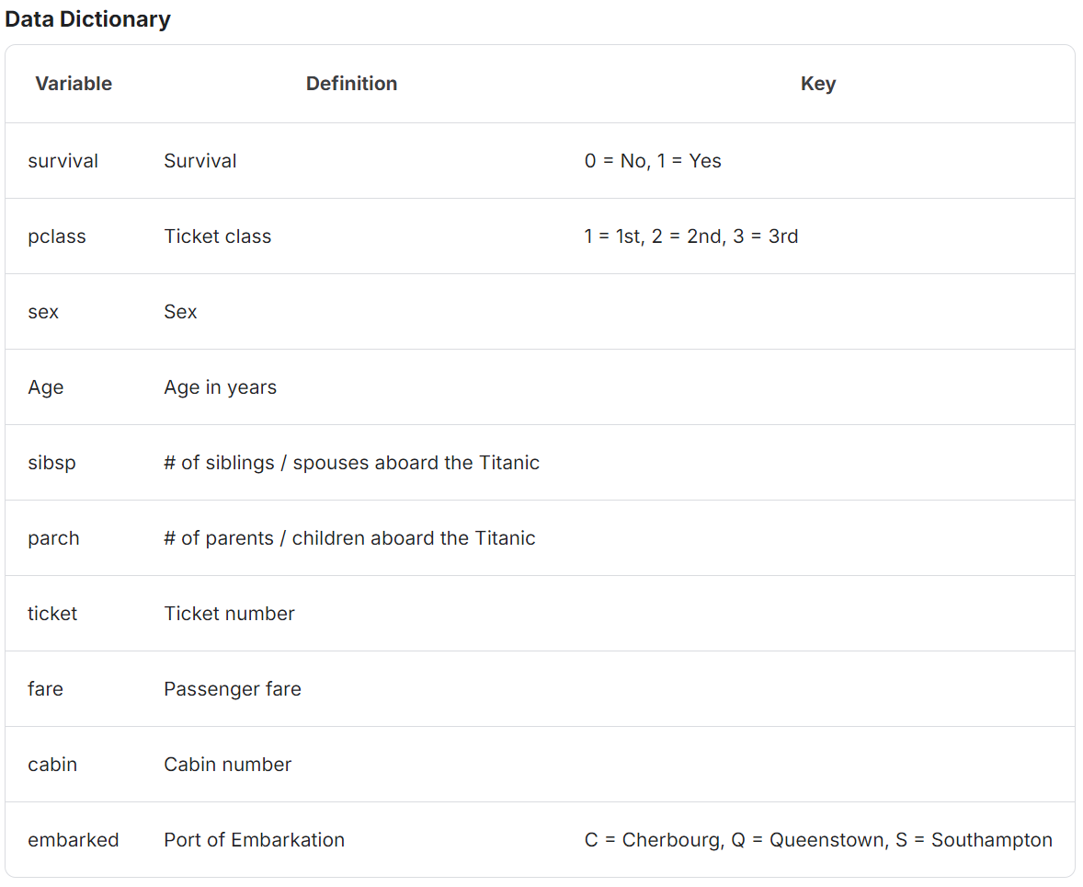
Dataset

Slide 8
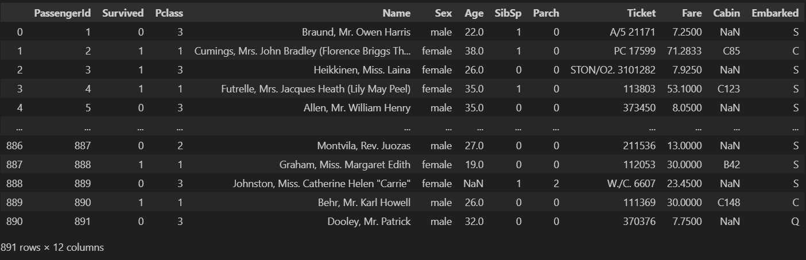

Slide 9
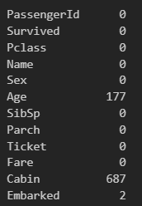
Impute with median!
Drop the column!

Slide 10
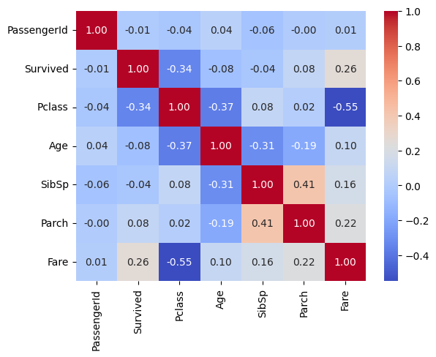

Slide 11
Initial Insights
Male
Female

Slide 12
Initial Insights
577
314
Male
Female

Slide 13
38.38%
74.20%
18.90%
Overall Survival
Rate
Survival Rate For Female
Survival Rate For Male

Slide 14
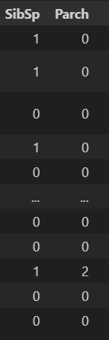


Slide 15
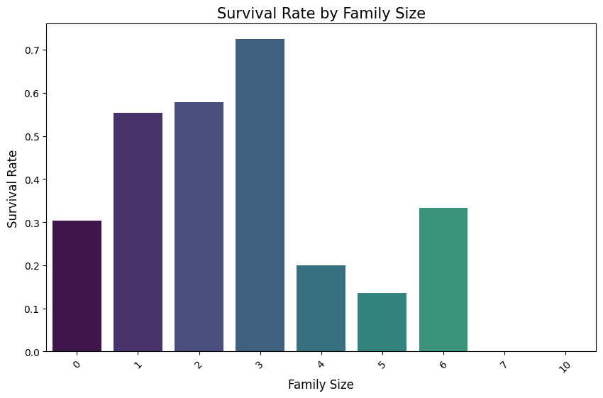
Moderate family sizes enhance survival chances!

Slide 16

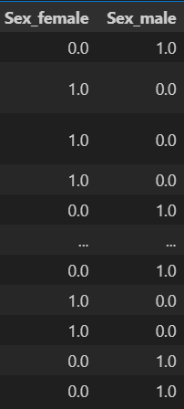
One-Hot Encode Sex column

Slide 17

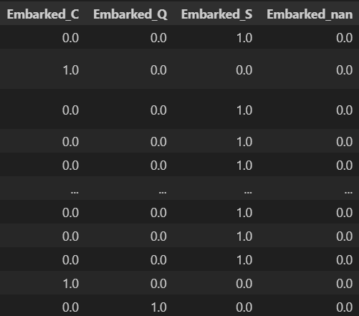
One-Hot Encode Embarked Column

Slide 18
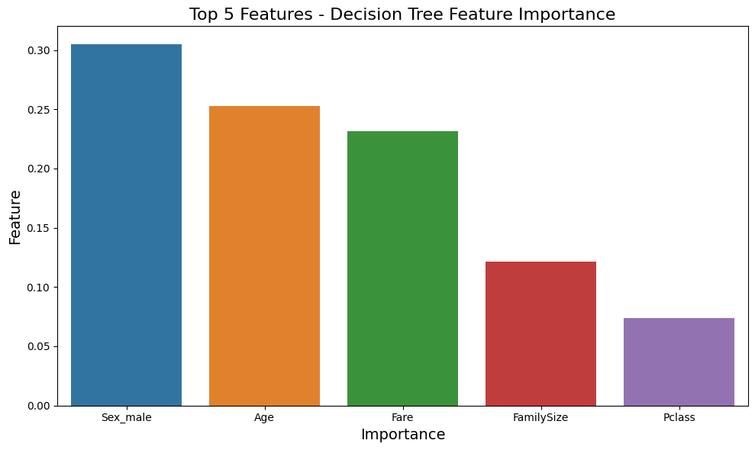
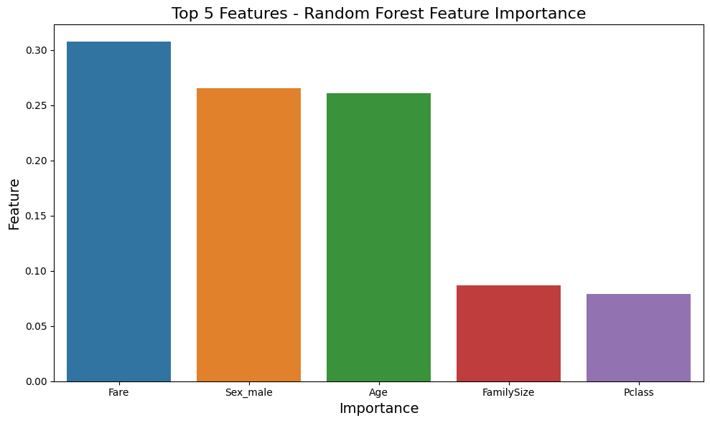

Slide 19

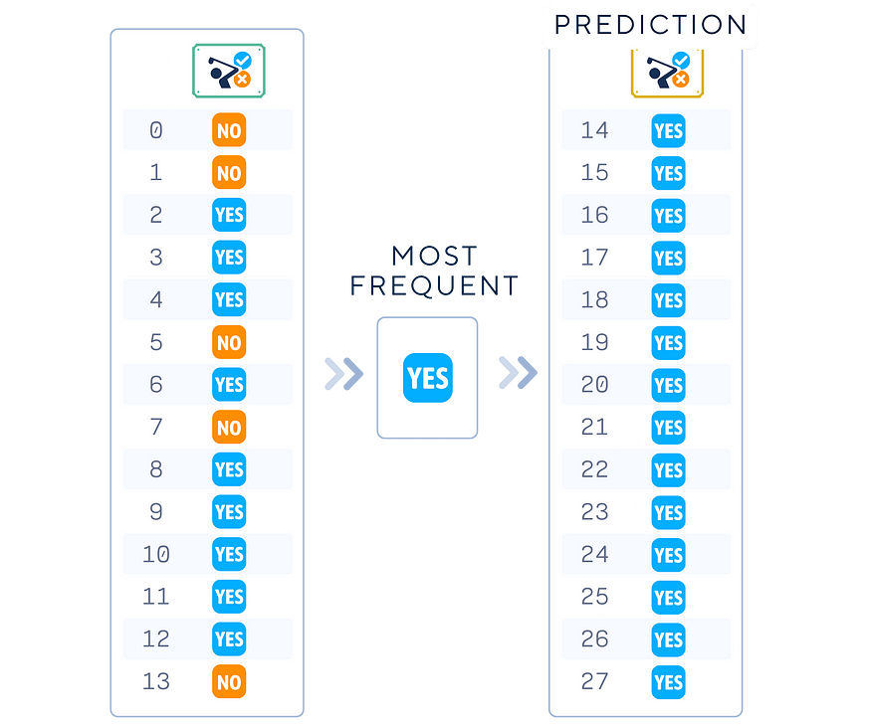
Dummy Classifier
Makes predictions using basic rules (predicting most frequent class)
Serves as a baseline for comparing more complex models (e.g Random Forest).
Accuracy: 0.65
CV Score: 0.62

Slide 20
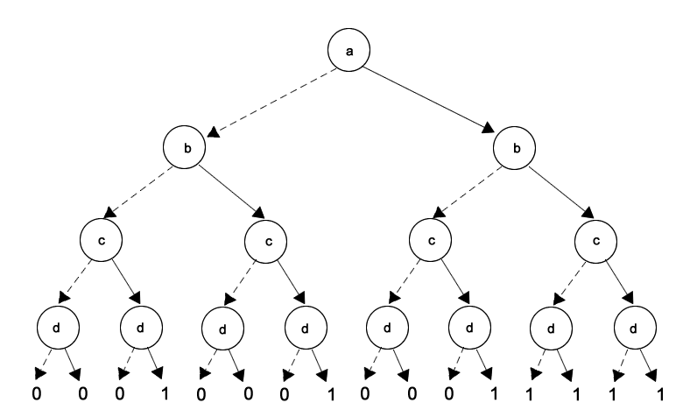
Decision Tree
Outlines the complex consequences of each decision
Basis for other ML methods such as Random Forest and XGBoost
Accuracy: 0.76
CV Score: 0.77

Slide 21
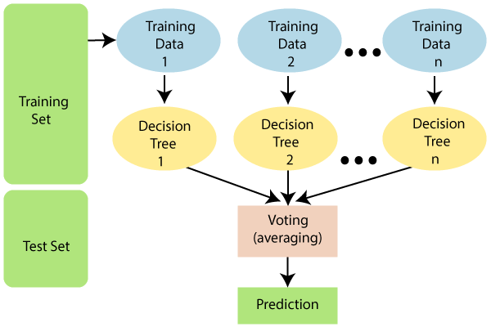
Random Forest
Combines output of multiple decision trees to find the best prediction
Achieved the best score for both Accuracy and CV
Accuracy: 0.86
CV Score: 0.84

Slide 22
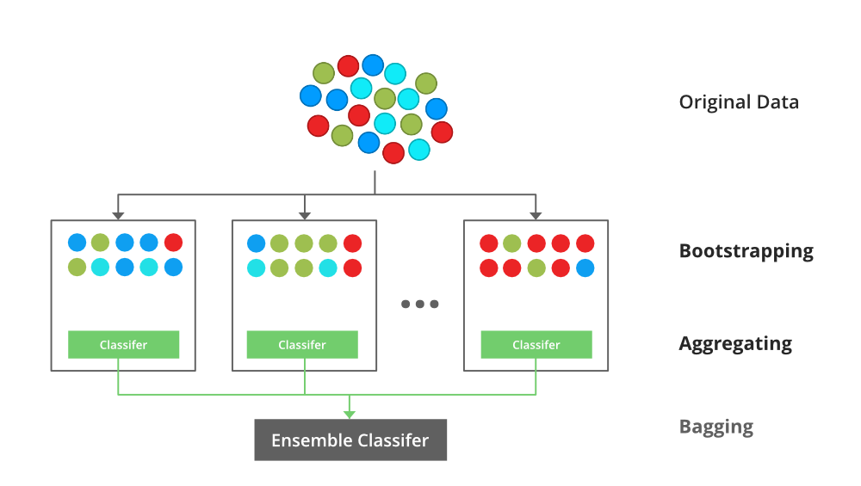
XGBoost
Optimised method of gradient boosting (Extreme Gradient Boosting)
Accuracy: 0.82
CV Score: 0.82

Slide 23
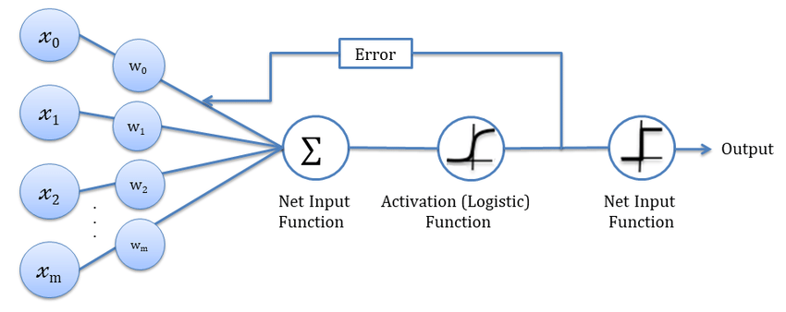
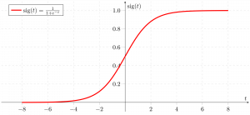
Logistic Regression
Fundamental classification algorithm widely used for binary outcomes
Accuracy: 0.81
CV Score: 0.79

Slide 24
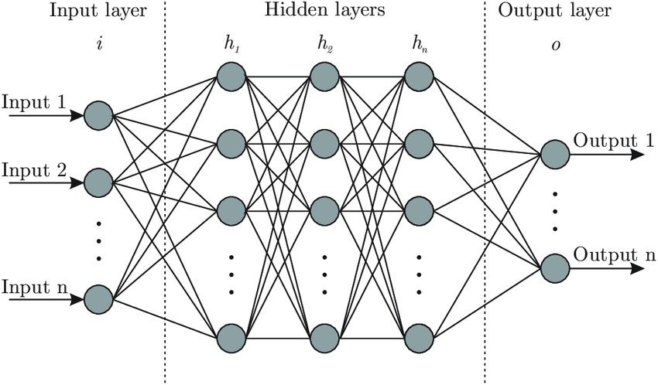
DNN
Using multiple layers of interconnected neurons that gradually learnt complex representation of the data.
Accuracy: 0.84
Validation Loss: 0.40

Slide 25
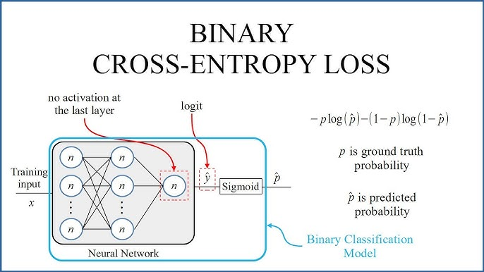

Slide 26
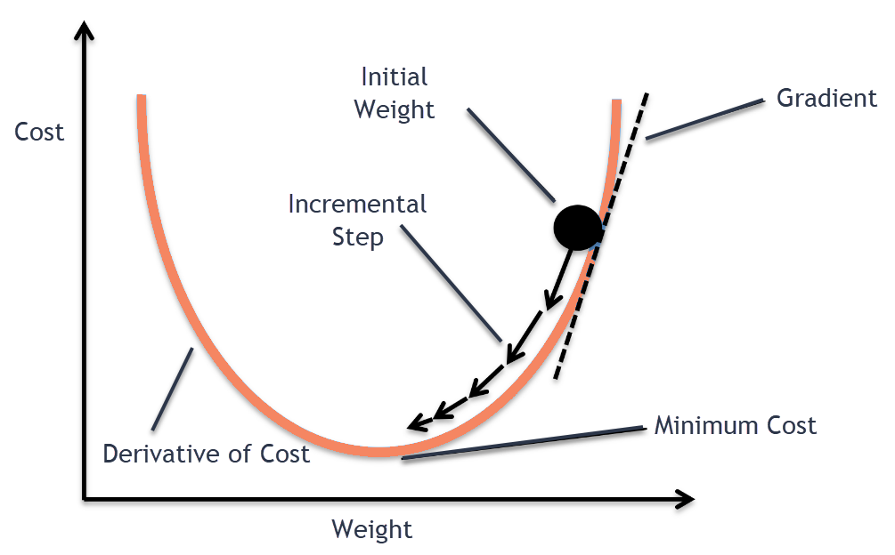

Slide 27
Conclusion
What we learnt:
Our best model (Random Forest) has an accuracy of 86%
It is still not possible to accurately decide whether a passenger will survive based on their statistics

Slide 28
Jupiter
Neptune
Saturn
Mars
Jupiter is the biggest planet in the Solar System
Neptune is the eighth planet from the Sun
Saturn has a high number of moons, like Jupiter
Despite being red, Mars is actually a cold place
01
02
03
04
This template has been created by Slidesgo

Slide 29
Background Infographics
Mercury
Mars
Venus is extremely hot, even more than Mercury
Venus has a beautiful name, but also high temperatures
Jupiter is a gas giant and has around eighty moons
Jupiter is the biggest planet in the Solar System
Saturn has a high number of moons, like Jupiter
Saturn is the second-largest planet in the Solar System
Neptune is the fourth-largest planet in the Solar System
Neptune is the eighth planet from the Sun
This template has been created by Slidesgo

Slide 30
Background Infographics
Overall Survival Rate
Jupiter
Jupiter is the biggest planet in the Solar System
38.38%
Saturn has a high number of moons, like Jupiter
40%
Earth
Mars
75%
Despite being red, Mars is actually a cold place
Earth is the third planet from the Sun and has life
60%
This template has been created by Slidesgo

Slide 31
Initial Insights
38.38%
75%
50%
25%
Jupiter
Neptune
Venus
Saturn
Jupiter is the biggest planet in the Solar System
Neptune is the eighth planet from the Sun
Venus is the second planet from the Sun
Saturn is composed of hydrogen and helium
This template has been created by Slidesgo

Slide 32
1.
EDA
Exploring the data to gain relevant insights

Slide 33
Background Infographics
Mercury
Neptune
Saturn
Mercury is a small planet
Neptune is an ice giant
Saturn is the ringed planet
Jupiter
Mars
Earth
Jupiter is a huge gas giant
Mars is full of iron oxide dust
Earth is the planet with life
This template has been created by Slidesgo

Slide 34
Background Infographics
Mercury
Saturn
Mercury is a small planet
Saturn is the ringed planet
Neptune
Jupiter
Neptune is an ice giant
Jupiter is a huge gas giant
Earth
Mars
Earth is the planet with life
Mars is full of iron oxide dust
This template has been created by Slidesgo

Slide 35
Background Infographics
Pluto
Mercury
Saturn
Mercury is a small planet
Saturn is the ringed planet
Jupiter
Neptune
Mars
Earth
Jupiter is a huge gas giant
Neptune is an ice giant
Mars is full of iron oxide dust
Earth is the planet with life
This template has been created by Slidesgo

Slide 36
Background Infographics
Mercury
Jupiter is a gas giant and the biggest planet in the Solar System. It’s the fourth-brightest object in the night sky. It was named after the Roman god of the skies and lightning
01
02
03
Mercury
Neptune
Saturn
Mercury is a small planet
Neptune is an ice giant
Saturn is the ringed planet
This template has been created by Slidesgo

Slide 37
Background Infographics
Earth
Earth is the third planet from the Sun and the only one that harbors life in the Solar System
Jupiter
Jupiter
Neptune
Saturn
Jupiter is the biggest planet in the Solar System
Jupiter is the biggest planet in the Solar System
Neptune is the eighth planet from the Sun
Saturn has a high number of moons, like Jupiter
1/5
2/5
3/5
3/5
This template has been created by Slidesgo

Slide 38
Background Infographics
Earth
Saturn
01
02
Earth is the third planet from the Sun and has life
Saturn has a high number of moons, like Jupiter
40%
Mercury
Mars
30%
60%
Venus
Jupiter
70%
This template has been created by Slidesgo

Slide 39
Background Infographics
Jupiter
Saturn
Jupiter is the biggest planet in the Solar System
Saturn has a high number of moons, like Jupiter
Mercury
Neptune
Mars
Neptune is the eighth planet from the Sun
Despite being red, Mars is actually a cold place
This template has been created by Slidesgo

Slide 40
Background Infographics
50%
Earth is the third planet from the Sun and has life
Earth
Earth is the planet on which we all live
Earth is the only planet known to harbor life
5%
Venus
Venus has a beautiful name, but also high temperatures
75%
Venus has a toxic atmosphere
20%
Saturn is the second-largest planet in the Solar System
Saturn
Saturn was named after a Roman god
Saturn has a high number of moons, like Jupiter
This template has been created by Slidesgo

Slide 41
Background Infographics
Saturn
70%
30%
Saturn is the second-largest planet in the Solar System
Mercury
Neptune
Earth
Jupiter
Mars
Mercury is a small planet
Neptune is an ice giant
Earth is the planet with life
Jupiter is a huge gas giant
Mars is full of iron oxide dust
This template has been created by Slidesgo

Slide 42
Background Infographics
Mars
Mars is full of iron oxide dust
Jupiter
Jupiter is a huge gas giant
Saturn
Saturn is the ringed planet
Neptune
Neptune is an ice giant
Mercury
Mercury is a small planet
This template has been created by Slidesgo

Slide 43
Background Infographics
Venus
01
Venus has a beautiful name, but also high temperatures
Jupiter
02
Jupiter is the biggest planet in the Solar System
Saturn
03
Saturn is the second-largest planet in the Solar System
Neptune
04
Neptune is the eighth planet from the Sun
This template has been created by Slidesgo

Slide 44
Background Infographics
Neptune is the eighth planet from the Sun
Neptune
Earth is the only planet known to harbor life
Earth
Jupiter
Jupiter is the biggest planet in the Solar System
Saturn is a gas giant and has several rings
Saturn
Pluto is considered a dwarf planet
Pluto
Despite being red, Mars is actually a cold place
Mars
This template has been created by Slidesgo

Slide 45
Background Infographics
Mercury is the smallest planet of them all
Mercury
Mercury
10%
01
Mercury is a small planet
Neptune
40%
Neptune is the farthest planet from the Sun
Neptune
02
Neptune is an ice giant
Jupiter
50%
Jupiter is the biggest planet in the Solar System
03
Jupiter
Jupiter is a huge gas giant
This template has been created by Slidesgo

Slide 46
Background Infographics
Mercury
Neptune
Jupiter
Saturn
Mercury is a small planet
Neptune is an ice giant
Jupiter is a huge gas giant
Saturn is the ringed planet
01
02
03
04
05
06
07
Pluto
Earth
Mars
It’s considered a dwarf planet
Earth is the planet with life
Mars is full of iron oxide dust
This template has been created by Slidesgo

Slide 47
Icon pack
This template has been created by Slidesgo

Slide 48
Instructions for use
If you have a free account, in order to use this template, you must credit Slidesgo in your final presentation.
As a Free user, you are allowed to:
Modify this template
Use it for both personal and commercial projects
You are not allowed to:
Sublicense, sell or rent any of Slidesgo Content
Distribute Slidesgo Content unless it has been expressly authorized by Slidesgo
Include Slidesgo Content in an online or offline database or file
Offer Slidesgo templates (or modified versions of Slidesgo templates) for download
Acquire the copyright of
Slidesgo Content
For more information about editing slides, please read our FAQs or visit our blog

Slide 49
Instructions for use (premium users)
As a Premium user, you can use this template without attributing Slidesgo
You are allowed to:
Modify this template
Use it for both personal and commercial projects
Share this template in an
editable format
Hide or delete the “Thanks” slide and the mention to Slidesgo in the credits
You are not allowed to:
Sublicense, sell or rent any of Slidesgo Content
Distribute Slidesgo Content unless it has been expressly authorized by Slidesgo
Use any of the elements that are part in a separated way
Register any of the elements as a trademark or logo in an intellectual property registry
For more information about editing slides, please read our FAQs or visit our blog

Slide 50
Infographics
You can add and edit some infographics to your presentation to present your data in a visual way.
Choose your favourite infographic and insert it in your presentation using Ctrl C + Ctrl V or Cmd C + Cmd V in Mac
Remember to choose the “Keep source formatting” option so that it keeps the design. For more info, please visit our blog
01
07
Select one of the parts and ungroup it by right-clicking and choosing “Ungroup”
Repeat the steps above with the other parts and when you’re done editing, copy the end result and paste it into your presentation
02
06
03
Change the color by clicking
on the paint bucket
05
Group the elements again by selecting them, right-clicking and choosing “Group”
Then resize the element by clicking and dragging one of the square-shaped points of its bounding box (the cursor should look like a double-headed arrow). Remember to hold Shift while dragging to keep the proportions
04

